Slide 1

Chapter
10
Developing
Business/Information
Technology Solutions

Slide 2
Starting the Systems Development Process
Systems Investigation Phase
  Feasibility studies
    Organizational feasibility
    Economic feasibility
    Technical feasibility
    Operational feasibility

Slide 3
Starting the Systems Development Process (continued)
  Cost/Benefit Analysis
    Tangible costs
    Intangible costs
    Tangible benefits
    Intangible benefits

Slide 4
Systems Analysis
Systems analysis is an in-depth study of end user information needs that produces functional requirements.

Slide 5
Systems Analysis (continued)
Traditionally involves a detailed study of…
  Information needs of the company & end users
  Activities, resources, & products of one or more of the present information systems
  The IS capabilities required to meet information needs of the company, the end users, and all business stakeholders that may use the system

Slide 6
Systems Analysis (continued)
Organizational analysis
  Study
    Management structure
    The people
    Business activities
    Environmental systems
    The current information system

Slide 7
Systems Analysis (continued)
Analysis of the present system
  Analyze how the present system..
    Uses hardware
    Uses software
    Is networked
    Uses people resources to convert data resources into information products.
    How the IS activities of input, processing, output, storage, and control are accomplished.

Slide 8
Systems Analysis (continued)
Functional requirements analysis
  What type of information does each business activity require?
    Format, volume, frequency, response times
  What are the information processing capabilities required?
    Input, processing, output, storage, control

Slide 9
Systems Analysis (continued)
Functional requirements analysis (continued)
  Finally, develop functional requirements
    End user information requirements that are not tied to the hardware, software, network, data, and people resources
  Goal – identify what should be done, not how to do it.

Slide 10
Systems Design
Specifies HOW the system will meet the information needs of users
Focuses on three major products
  User interface design
  Data design
    Database structures
  Process design
    Processing and control procedures

Slide 11
Systems Design (continued)
User interface design
  Focuses on supporting the interactions between end users and the computer-based applications
    Display screens
    Interactive user/computer dialogues
    Audio responses
    Forms, documents, and reports

Slide 12
Systems Design (continued)
System specifications
  Formalizes the design of the application’s user interface methods & products
  Formalizes database structures
  Formalizes processing and control procedures

Slide 13
End User Development
IS professionals play a consulting role
  Training in the use of application packages
  Assistance with the selection of hardware and software
  Assistance in gaining access to organization databases
  Assistance in the analysis, design, and implementation of your application

Slide 14
End User Development (continued)
The application development process
  Output
    What information is needed and in what form?
  Input
    What data are available? From what sources? In what form?

Slide 15
End User Development (continued)
The application development process (continued)
  Processing
    What operations or transformation processes will be required to convert available inputs into the desired output?
    What software package can best perform the required operations?

Slide 16
End User Development (continued)
The application development process (continued)
  Storage
  Control
    How will you protect against accidental loss or damage to end user files?

Slide 17
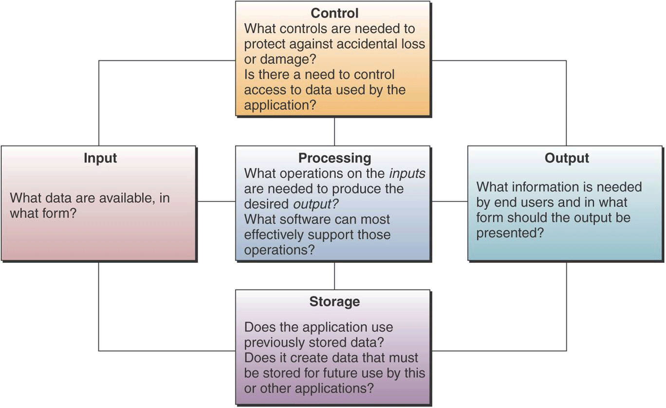
End User Development (continued)

